Slide 1


Slide 2
Revolutionary technology for detecting unexploded ordnance (UXO)
Gas powered long endurance drone
Extra wide large loop detector (up to width of football field) carried by multiple drones
Follow up close inspection drone (highest possible resolution for precise data collection, hopping from alert spot to alert spot, hovering over the spot )
Separated tasks for higher efficiency (iteration to optimized frequency and "energy shots")
Real time data for higher efficiency (incl. FPV)
Cloud based data storage and analysis (signal recognition by comparing incoming graph to cloud based stored ones, coming soon)

Slide 3
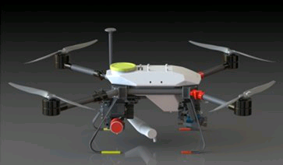
exuxo gas powered quad copter

Slide 4
Advantages of gas powered drone
5 hours of flight time without payload (pure topography pre-scan to prepare task)
3+ hours of flight time with either exuxo metal detector module
Refilling takes less than 5 minutes
Can travel up to 100 kilometers on a single tank (pre-scan), and scan 1km² in 2-10h, depending on swath sensor module.
Quadcopters are more energy efficient than hexa- and octacopters

Slide 5
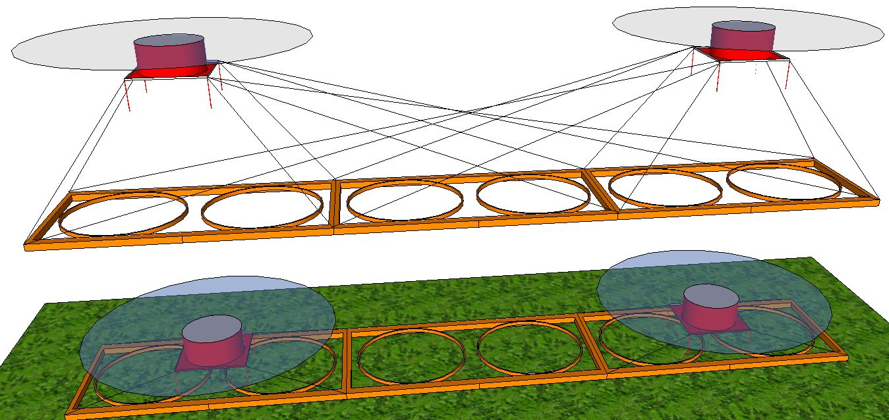
exuxo extra wide large loop detector

Slide 6
General wide large loop detector advantages
Current large loop detectors were designed for humans walking along in mine fields
Large loop detectors attached to ground based vehicles move unevenly across the ground
Drone based large loop detectors fly more evenly across fields and can adjust position rapidly with state of the art sensors
Can fly over or around obstacles better than humans or ground based vehicles
All ground based actions are prone to fatal accidents (explosions!)

Slide 7
exuxo extra wide large loop detector advantages
exuxo large loop detectors can range from 1m wide to 50m wide or more for max flexibility
Drastically reduces number of passes
Can fly at up to 50km/h (data quality loss is TBD, not yet found)
Stops for nothing - does not need to slow down or stop for more detailed analysis
Can scan a flat km² in as little as 2 hours

Slide 8
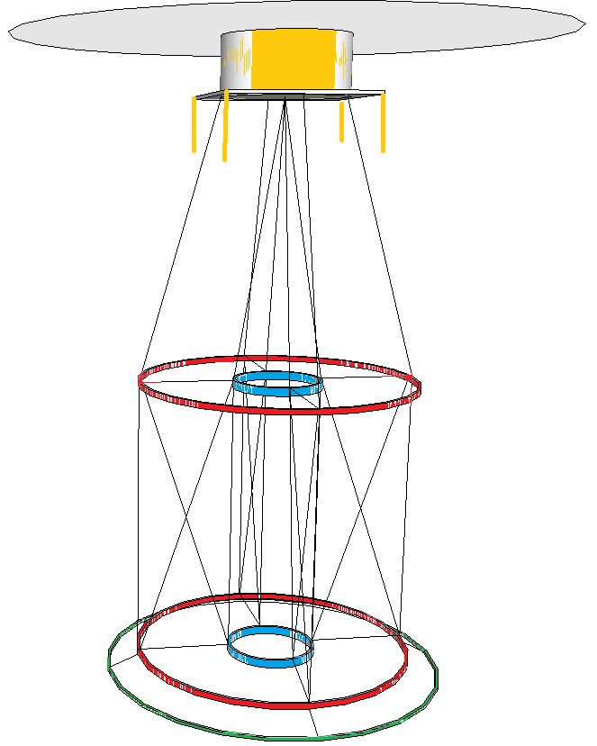
exuxo follow up close inspection drone based detector

Slide 9
General follow up close inspection detector advantages
Separates tasks - multiple systems working simultaneously
Detector module specifically designed for task eliminating need for either system to carry additional equipment
One or more close inspection detectors per extra wide large loop detector depending on mine field density

Slide 10
exuxo follow up close inspection drone based detector advantages
Receives signal from extra wide large loop detector and travels to point of interest (POI)
Examines POI closer to determine precise horizontal and vertical location of UXO
Collects max information about the detected object (size, shape, etc. sampling 2MSps)
Reduces number of false positives
Real time data transmission

Slide 11
exuxo centimeter precise mapping
The exuxo (farbe immer kostant!) drone based UXO detection system can:
fly very low above the ground
locate precise location of targets to within a few centimeters (RTK GPS)
indicate discovery on one or multiple connected devices (smartphone/tablet/etc.)
log discoveries on a map for real time or future analysis
Give out data in most known formats, analyze data by comparison with cloud based data.

Slide 12
Ready to go with our team
Little training required
No pilot required (though a human can override the autopilot at any time)
Easy to use for beginners alles weglassen!
Super adaptable for advanced users/module developers
EODs with 30 years of experience each eod in our team, we offer services and dont sell the system!

